Slide 1


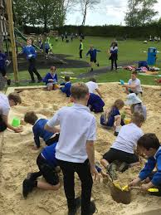
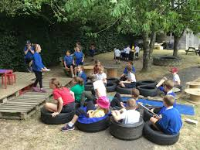
OPAL – Outdoor Play And Learning – Our School Story

Slide 2

What can you remember about our first OPAL assembly?
What does OPAL stand for?
What differences can you see at lunchtimes with OPAL play being in place?

Slide 3
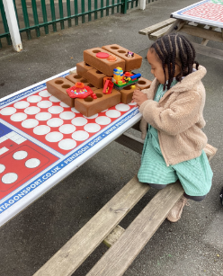
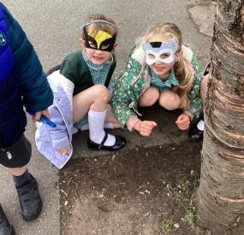
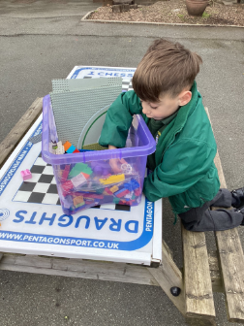

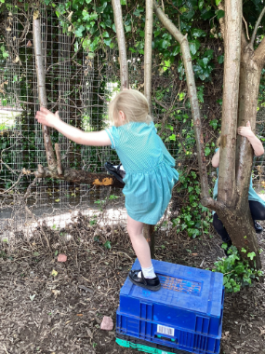
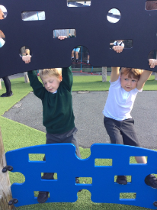

This is what I showed you last week.
Here is what OPAL can look like and will start to look like as we begin to develop it and make changes across our school…

Slide 4
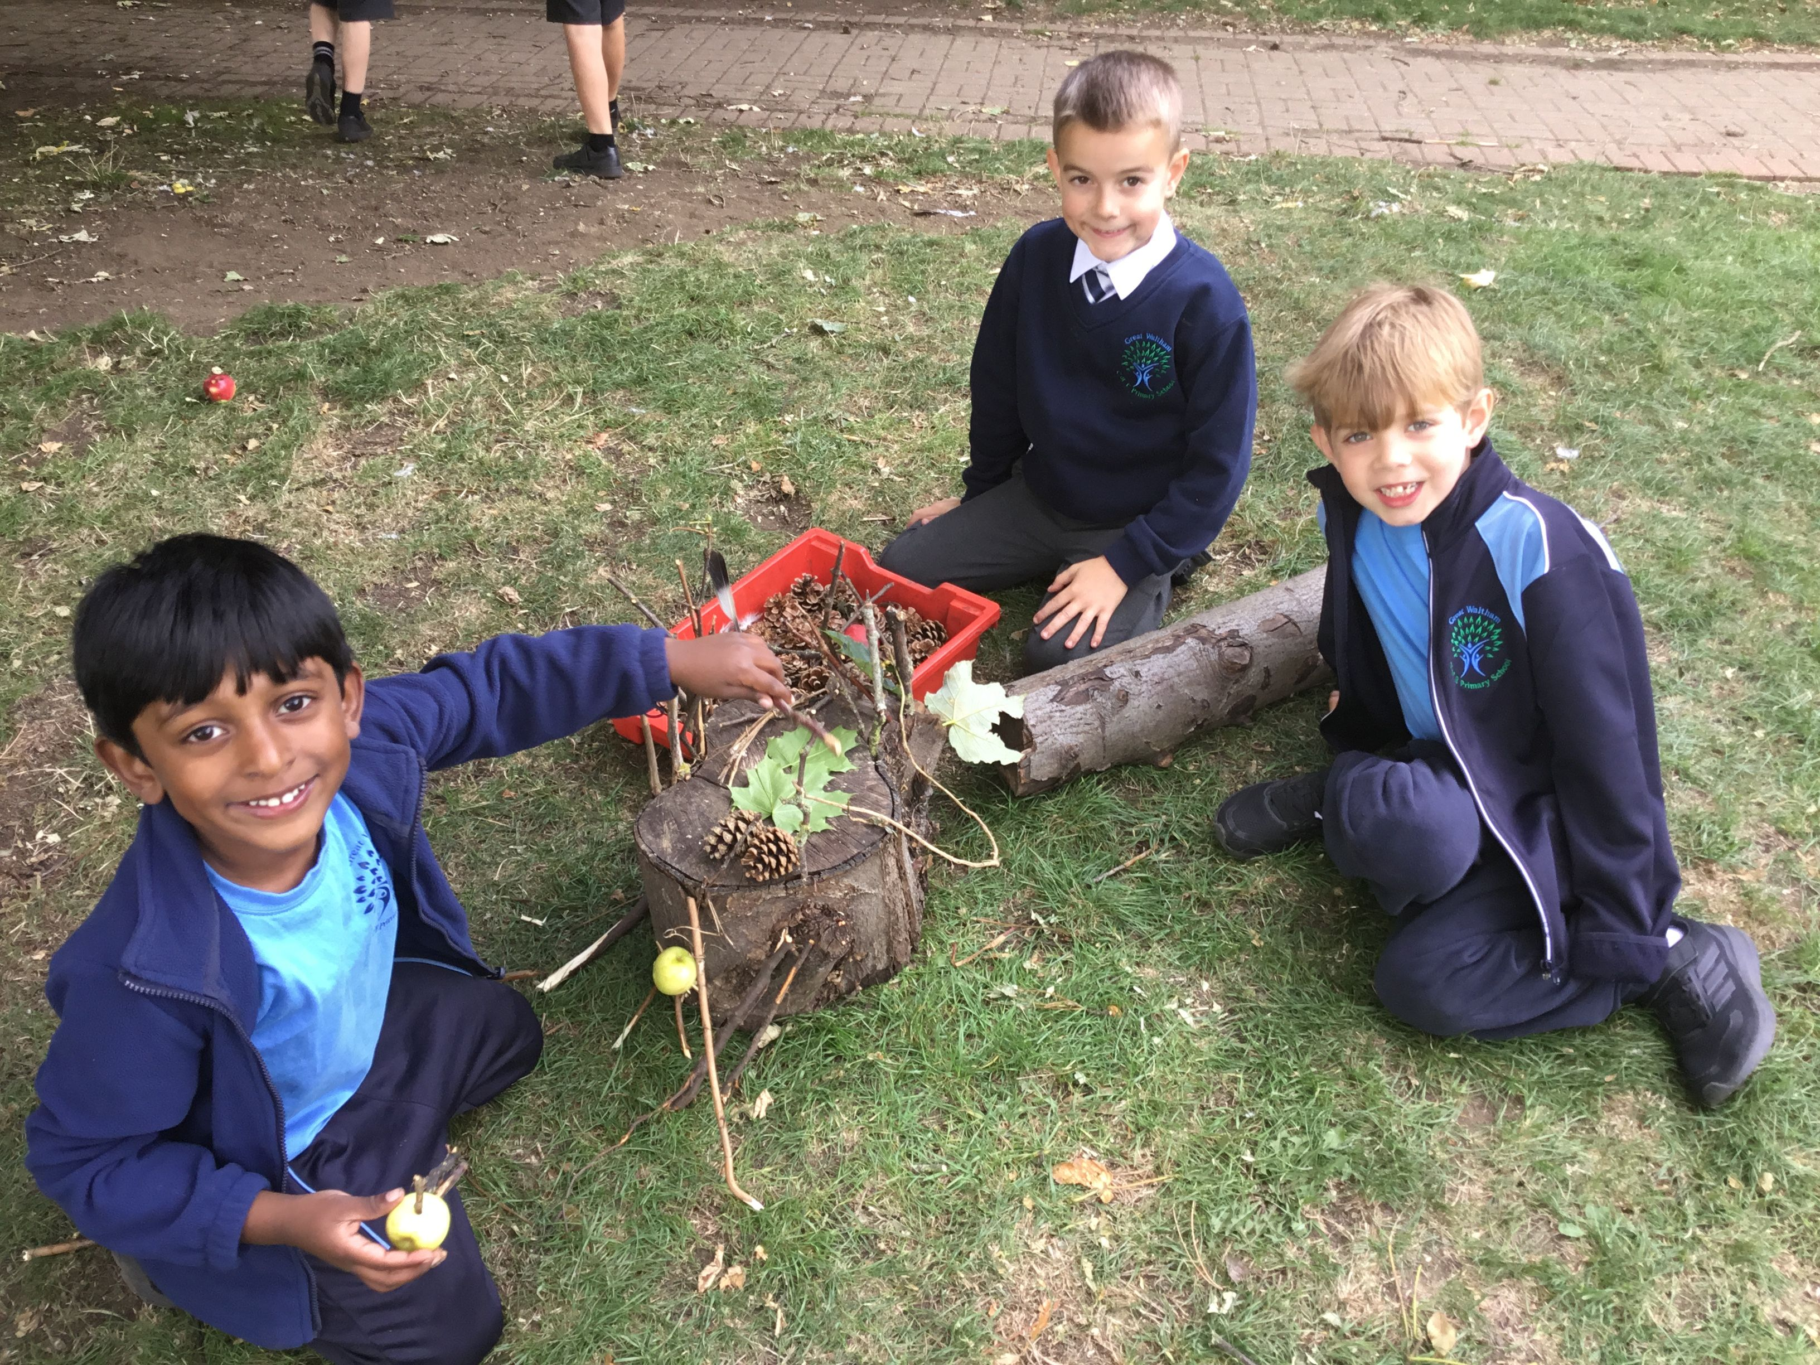
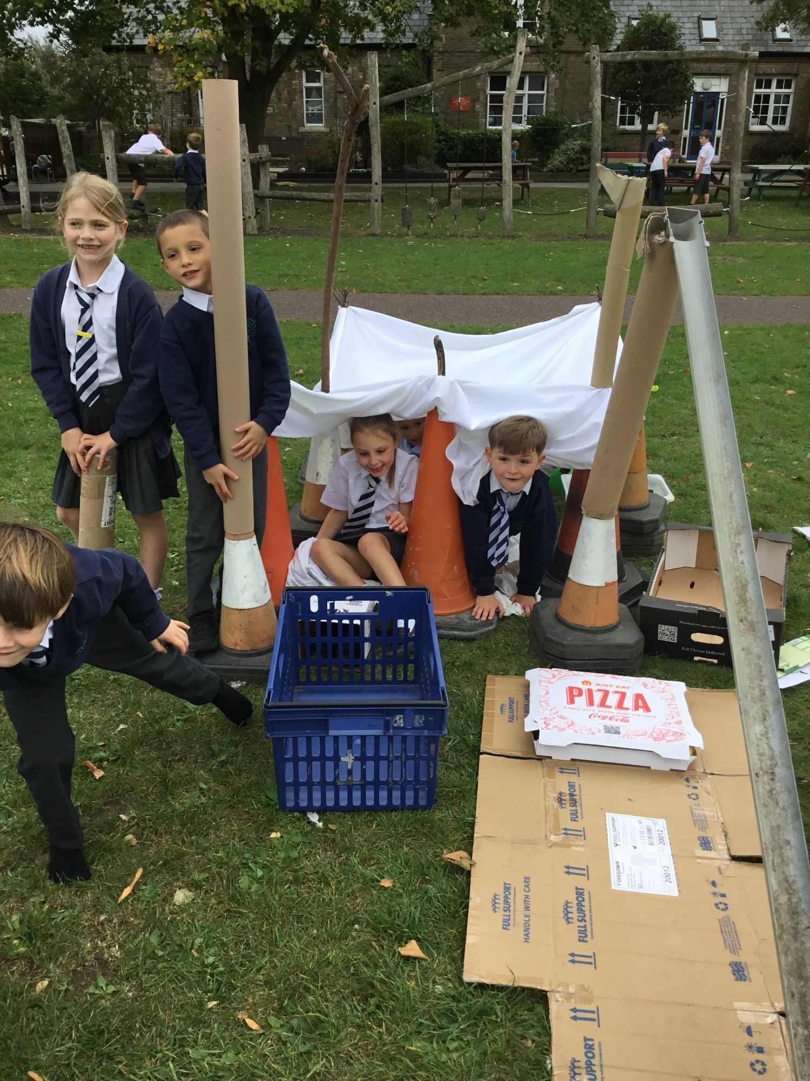
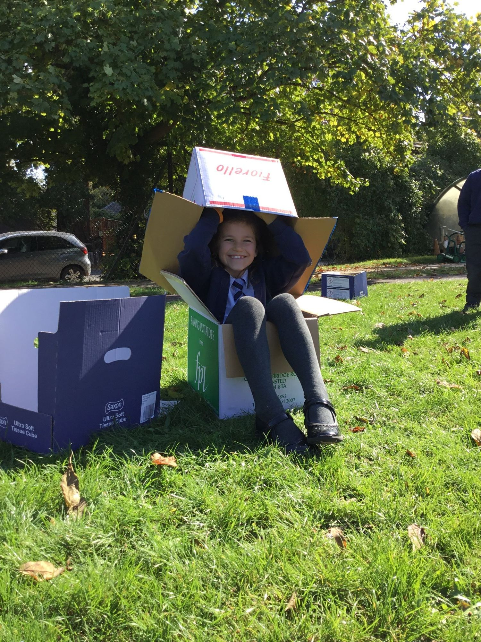
This is OPAL so far…

Slide 5
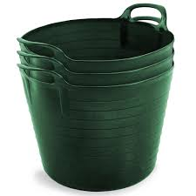
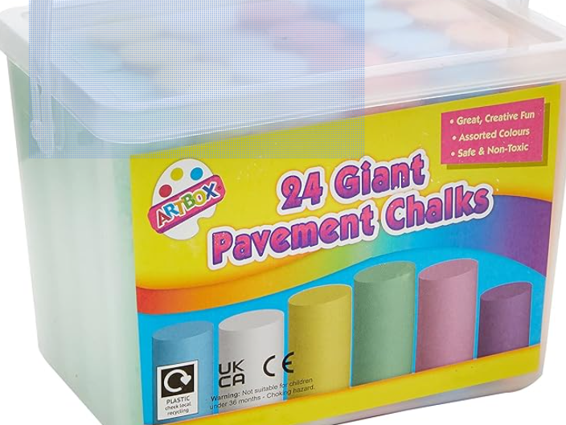
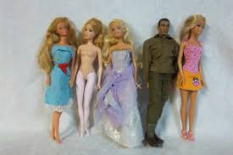
Assembly Number 2
We now have …

Slide 6

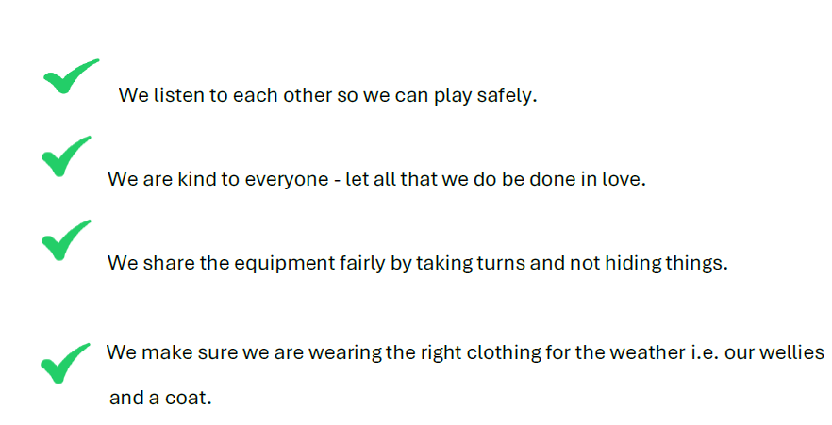
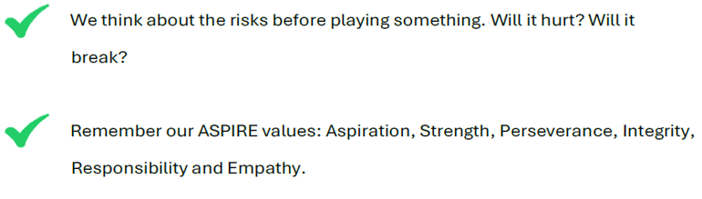
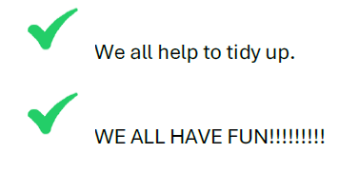
OPAL Play Charter

Slide 7
Risk Management - how are we going to stay Safe?
Thinking - think before you do something.
Checking - is what you are doing safe?
Looking - being aware of who or what is around you.
Listening - how will you know it is time to tidy up?
Has the bell been rung?

